Slide 1
Nessus Features
Lets take a look at Nessus features

Slide 2
Nessus Features
Nessus (Reports):
Customize reports to sort by vulnerability or host
Create an executive summary or compare scan results
Targeted email notifications of scan results

Slide 3
Nessus Features
Nessus (Scan Types):
Asset discovery
Un-credentialed vulnerability discovery
Credentialed scanning for system hardening & missing patches

Slide 4
Nessus Features
Nessus (Compliance & Config Scans):
Compliance auditing: FFIEC, FISMA, CyberScope, GLBA, HIPAA/ HITECH, NERC, PCI, SCAP, SOX
Configuration auditing: CERT, CIS, COBIT/ITIL, DISA STIGs, FDCC, ISO, NIST, NSA

Slide 5
Nessus Features
Nessus (Risk scores):
Vulnerability ranking based on CVE, five severity levels (Critical, High, Medium, Low, Info), customizable severity levels for recasting of risk

Slide 6
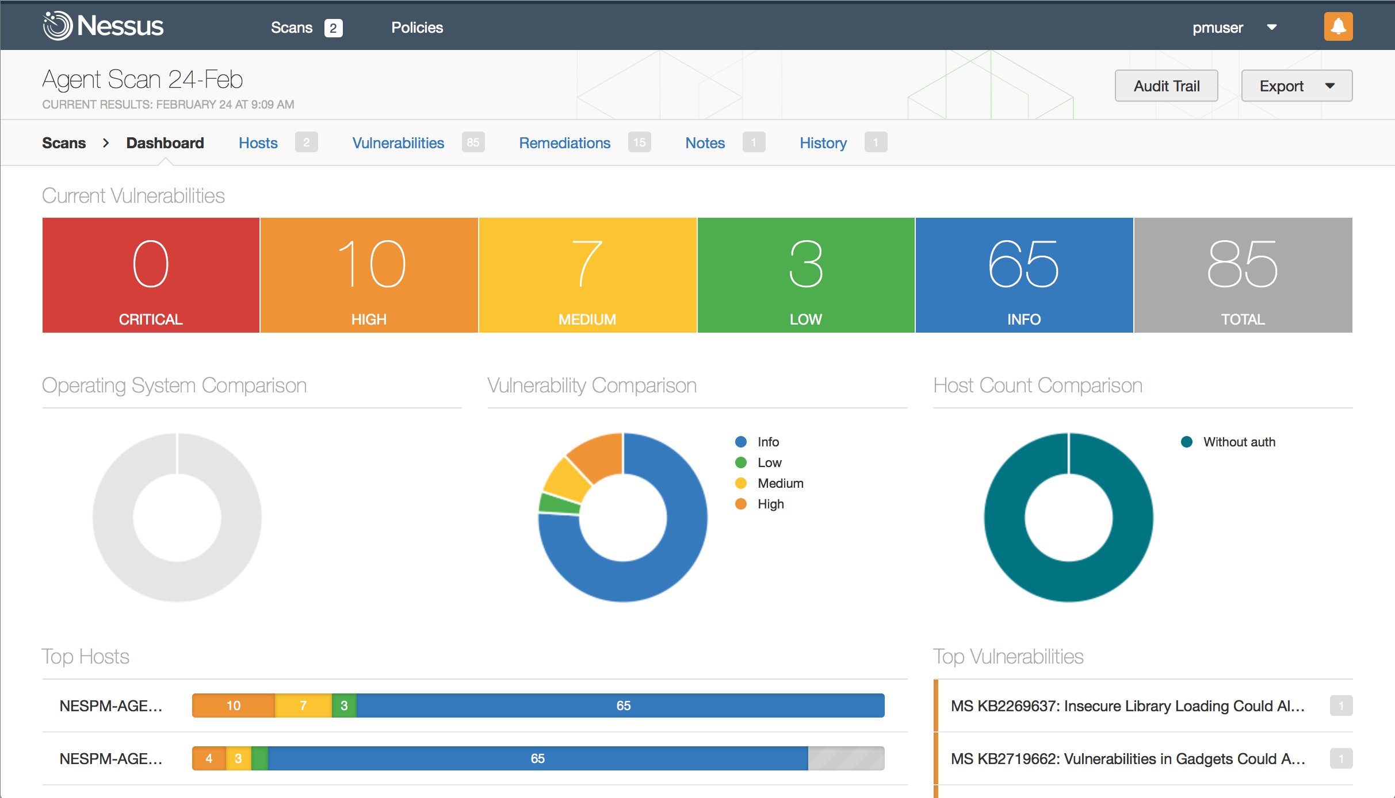
Nessus Features

Slide 7
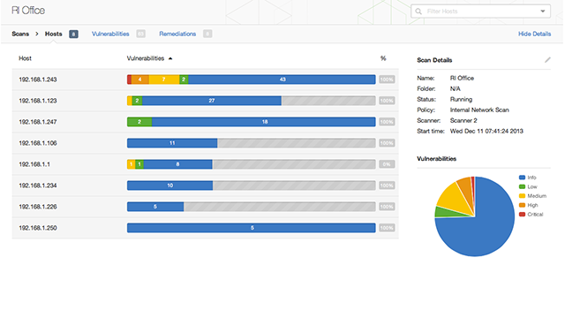
Nessus Features

Slide 8
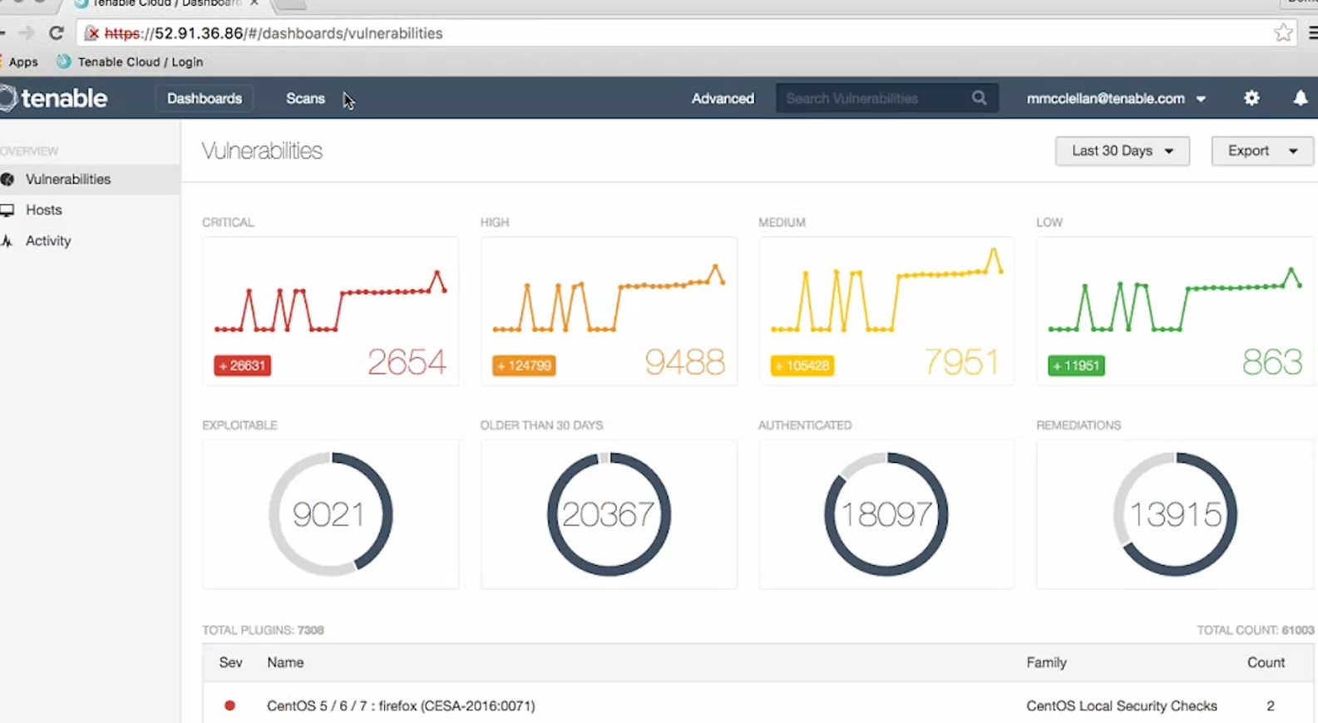
Nessus Features

Slide 9
Nessus Features
Nessus is a cost-effective scanner that gets most of the job done for vulnerability scanning
It has CIS and DISA compliance templates
Has some flaws and bugs but overall useful tool

